Slide 1

&
Interview

Slide 2
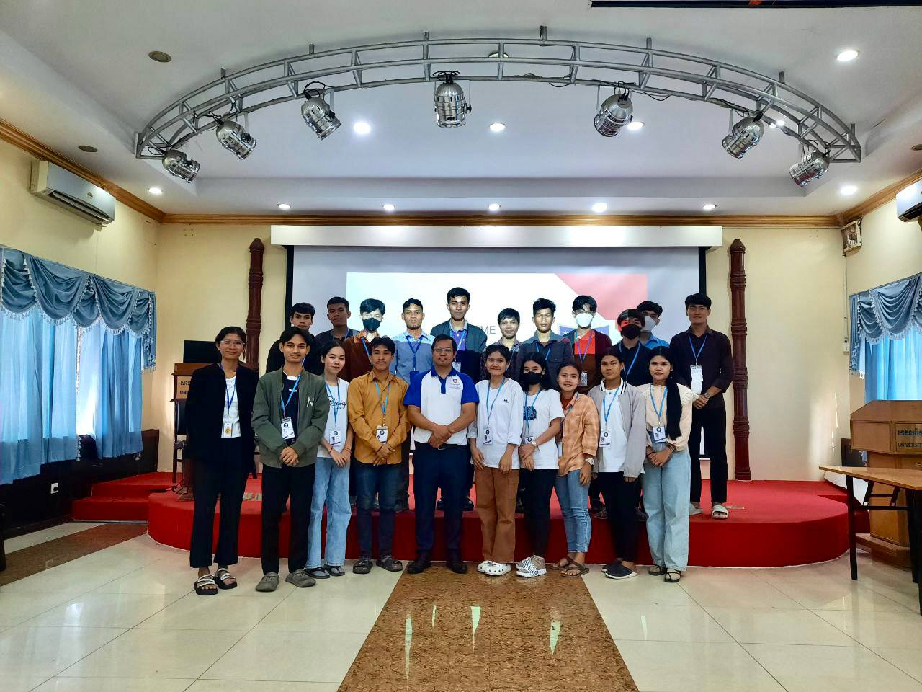
Agendas
Background
Information

Slide 3
Location of university Bachelor's Master Degree Uniform IT department Quality (E-learning System and Uperp)
Information

Slide 4
REQUIREMENT & ADMISSION
BaccII certificate
Associate degree
Credit 2 +

Slide 5
TUITION FEE
Discount 75% For PNC
500-600$/ Per Year

Slide 6
SCHEDULE STUDY
Monday to Friday
Year 1 and Year 2 Afternoon
Year 3 and Year 4 Evening
Saturday to Sunday
For master degree

Slide 7
SCHEDULE STUDY
Monday to Friday
Year 1 and Year 2 Afternoon
Year 3 and Year 4 Evening
Saturday to Sunday
For master degree

Slide 8
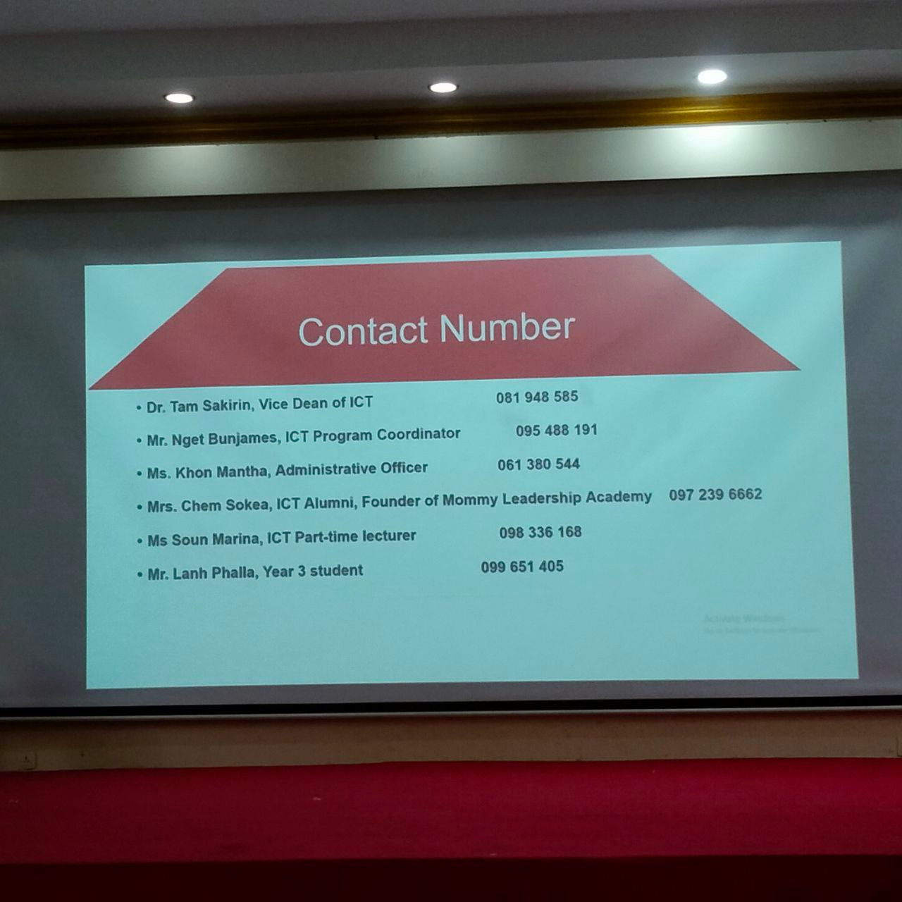

Slide 9
Interview Information
Before Go To Study
Need BaccII Certificate
Transcript 3 rule
Apply 100$ ( Depend)

Slide 10
Rule at School
Pay money(Fail Exam)
Can stop 3 day of a month
Uniform

Slide 11
Challenges
work & study
Teacher
Difficult to manager time

Slide 12
Thank you
for your attention

